Slide 1
Chat---Bots
Shubham Kumar​

Slide 2
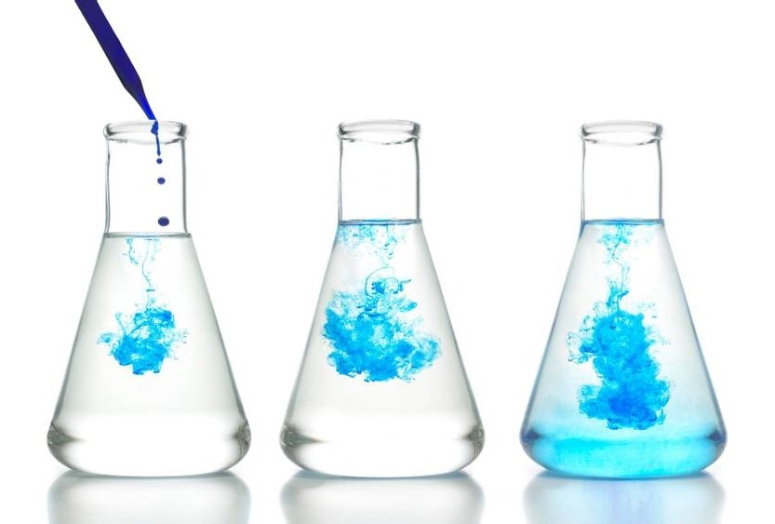
Itinerary:
Introduction
Rule-Based bot
Research paper analyzer
Application And Uses
Summary

Slide 3

Introduction
A CHATBOT is a computer program that simulates human conversation with an end user. Though not all chatbots are equipped with artificial intelligence (AI), modern chatbots increasingly use conversational AI techniques like natural language processing (NLP) to understand the user’s questions and automate responses to them.
The ability of AI chatbots to accurately process natural human language and automate personalized service in return creates clear benefits.

Slide 4
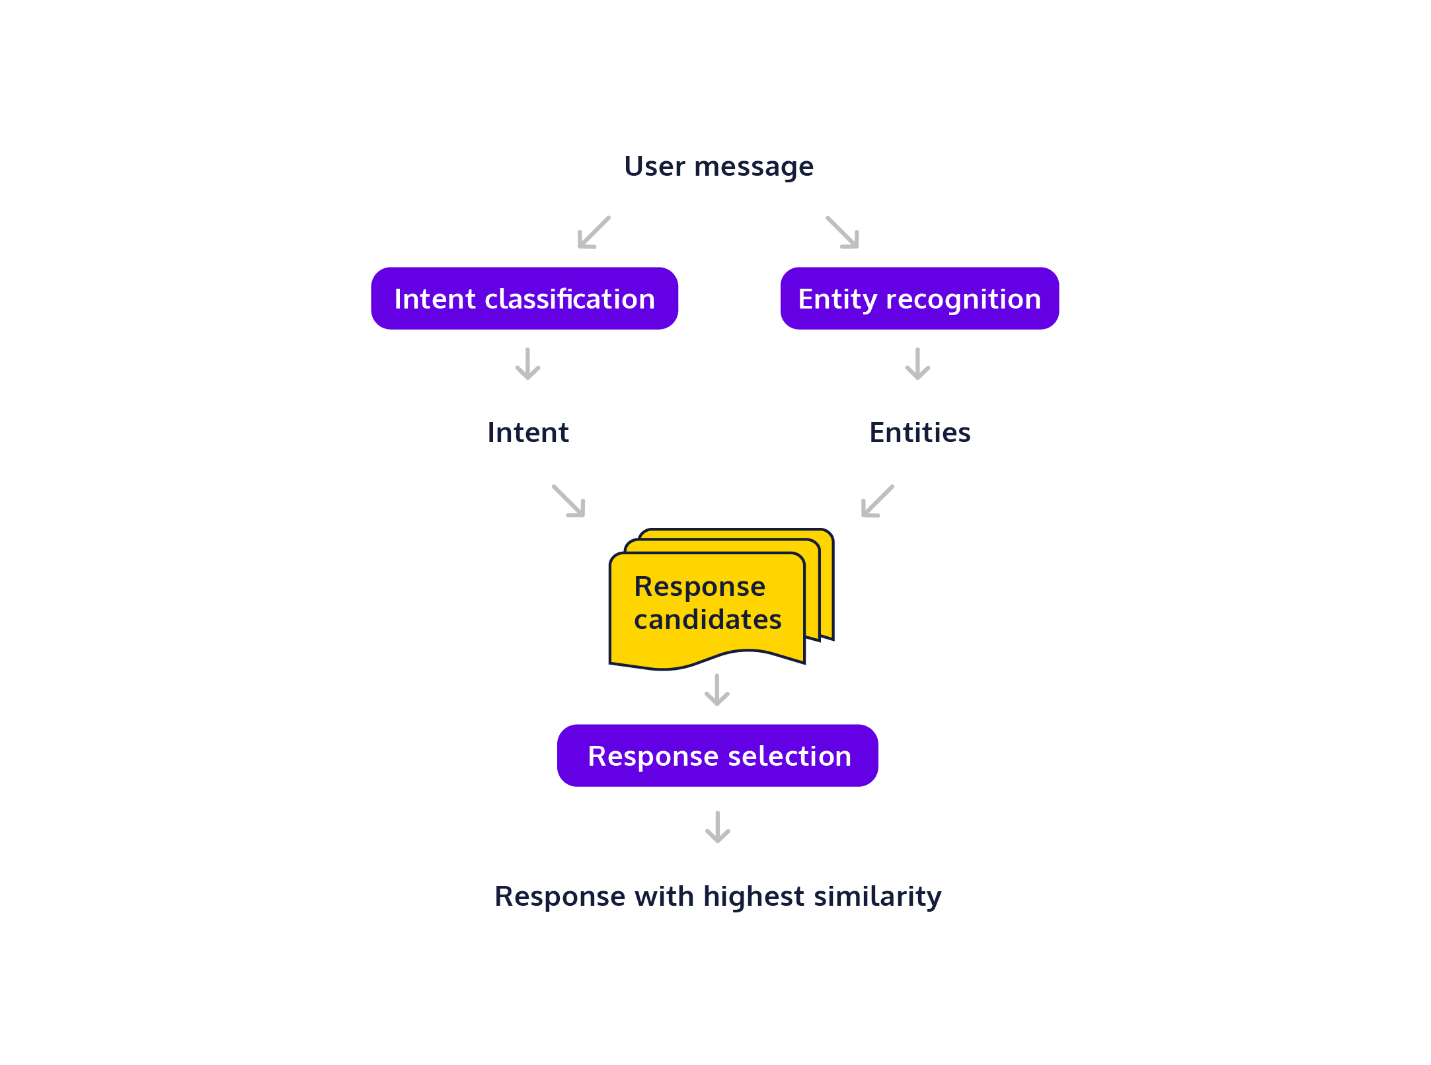
flowchart
A rule-based chatbot is a type of chatbot that operates on a predefined set of rules and guidelines.
Predefined Rules: Rule-based chatbots rely on explicitly defined rules and decision trees to interact with users. These rules are typically created by developers and dictate how the chatbot responds to user inputs.
Keyword Matching: Responses in rule-based chatbots are often triggered by keyword matching. If a user's input contains specific keywords or phrases, the chatbot responds accordingly
Tools and language:
Python , re library, random library

Slide 5
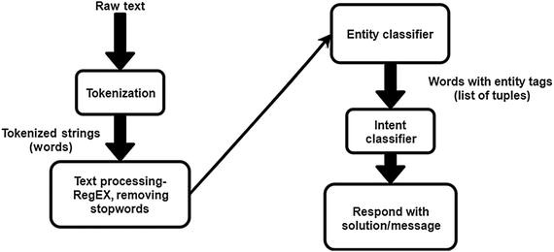
flowchart
Self-learning chatbots, often referred to as AI-driven or machine learning chatbots, have the ability to learn and improve their performance over time without explicit programming.
Natural Language Processing (NLP): Implement NLP techniques to process and understand user input. This includes tokenization, part-of-speech tagging, named entity recognition, and sentiment analysis.
KEY POINTS :
TOKENIZATION: Breaking Down Each Text as word referred to “Token”.
STEMMING: Text Normalization which reduce words to “ROOT” Form.
LEMMATIZATION: Reduces Words to Dictionary Form.
Tools and language:
NLTK, NUMPY, String, random, scikit-learn

Slide 6
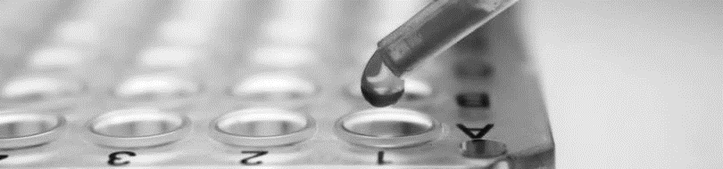
Research Paper Analyzer Bot use NLP technique and try to extract the Meaning from it
It studied the Research Paper like Human and Use its Intelligence for connecting with real time examples.

Slide 7

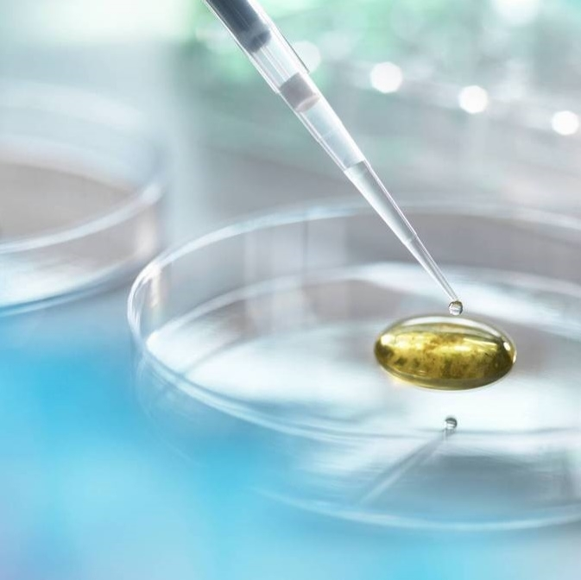
Thank you
insshubh22@gmail.com

